Slide 1
Time series data + Domain adaptation/generalization
魏煜华
2020.12.03

Slide 2
Variational Recurrent Adversarial Deep Domain Adaptation (ICLR 2017)
we address this problem with a model that learns temporal latent dependencies between the latent variables across timesteps that can be transferred across domains that experience different distributions in their features
Use variational methods to produce a latent representation that captures underlying temporal latent dependencies
Perform adversarial training on this representation similarly to the Domain Adversarial Neural Network (DANN)

Slide 3
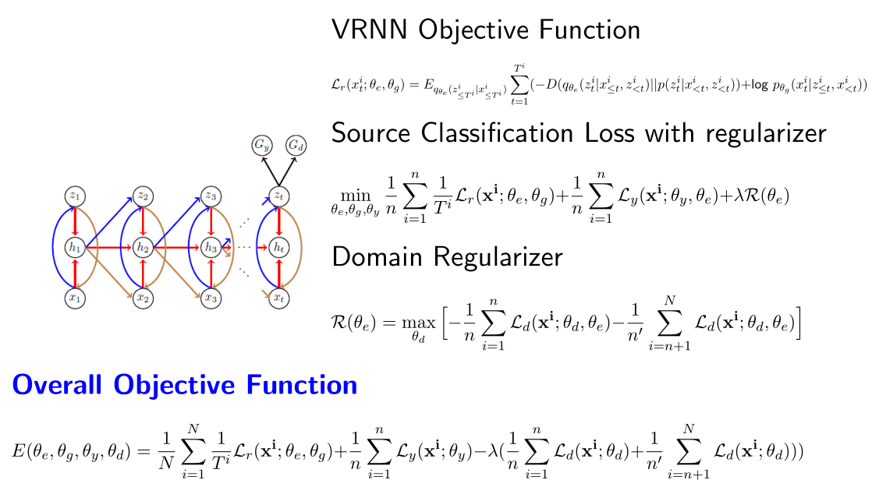
1. Uses a VRNN to model and transfer complex domain-invariant temporal latent relationships for unsupervised domain adaptation of multivariate time-series.
2. Achieving domain adaptation via the latent representation

Slide 4
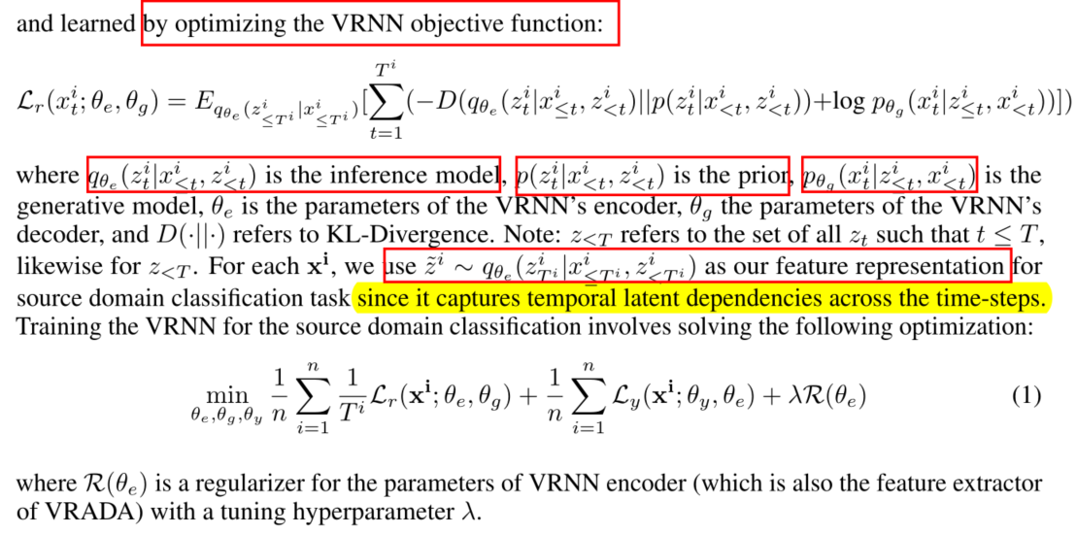
1. Uses a VRNN to model and transfer complex domain-invariant temporal latent relationships for unsupervised domain adaptation of multivariate time-series.
2. Achieving domain adaptation via the latent representation

Slide 5
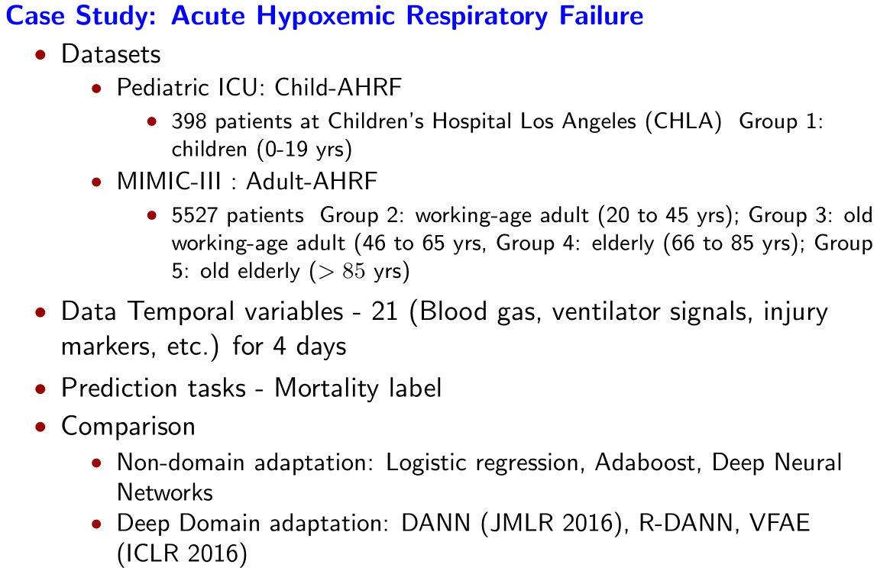

Slide 6
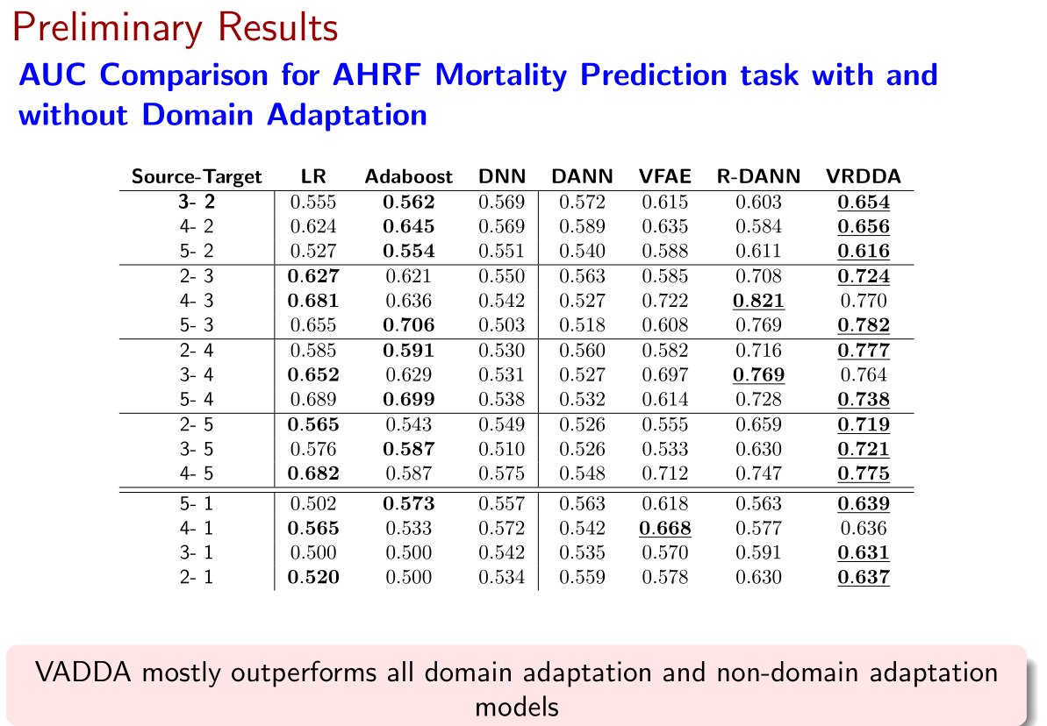

Slide 7
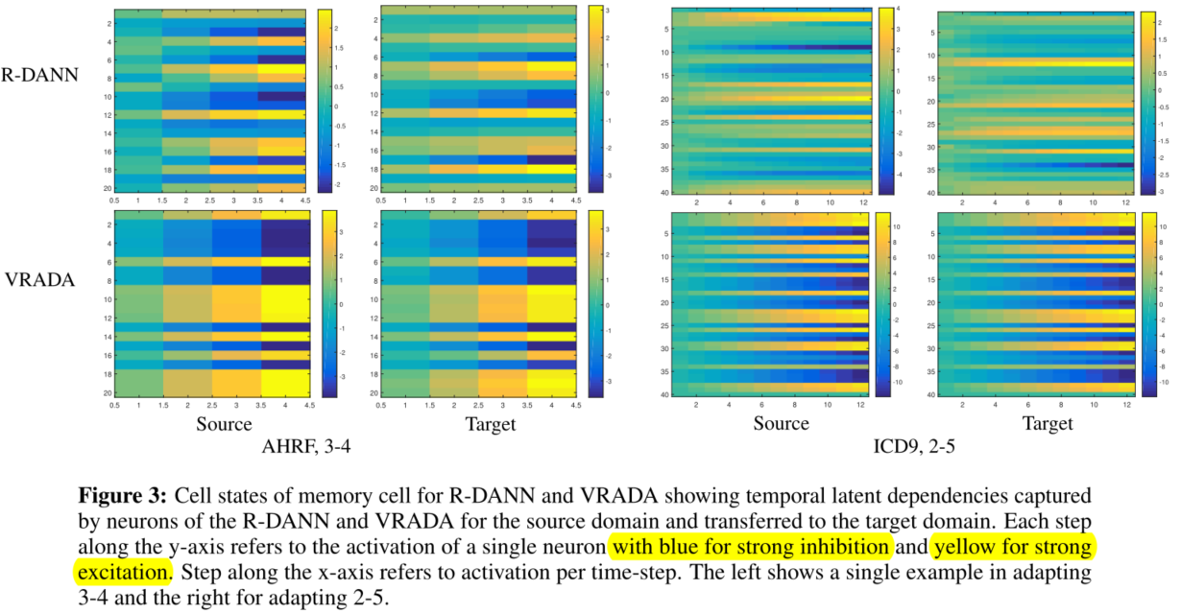

Slide 8
Multi-Source Deep Domain Adaptation with Weak Supervision for Time-Series Sensor Data (KDD 2020)
While less numerous, researchers have introduced a few time series adaptation methods (VRADA, R-DANN…)
We include the two most related approaches, VRADA and R-DANN, as baseline models in our empirical study.
Convolutional deep Domain Adaptation model for Time Series data (CoDATS)
Domain Adaptation with Weak Supervision (DA-WS) method by utilizing weak supervision in the form of target-domain label distributions

Slide 9
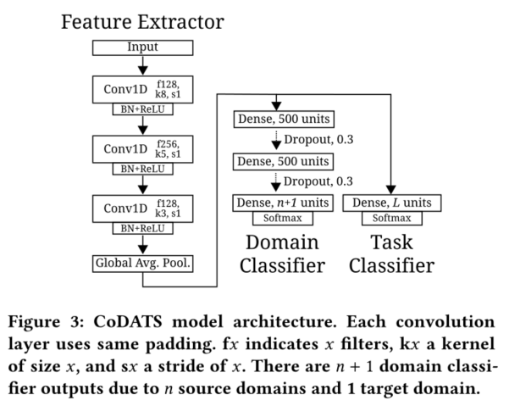
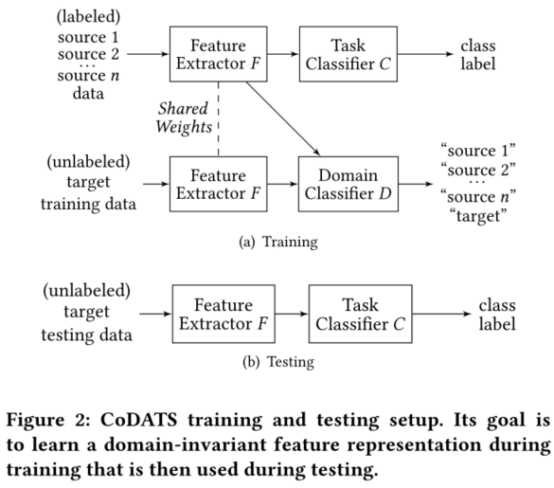

Slide 10
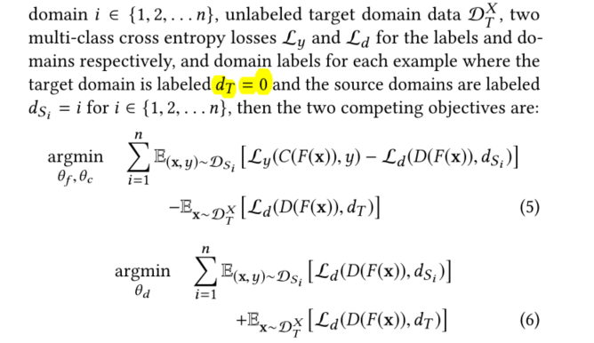
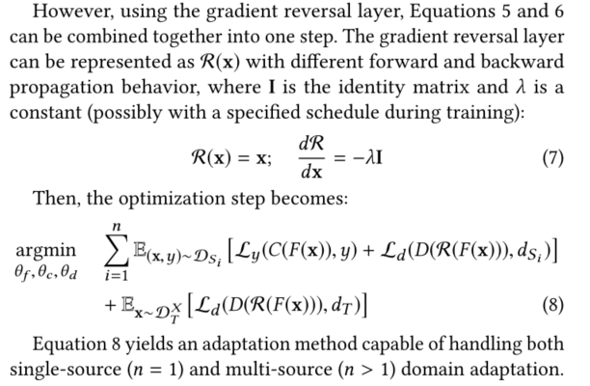

Slide 11
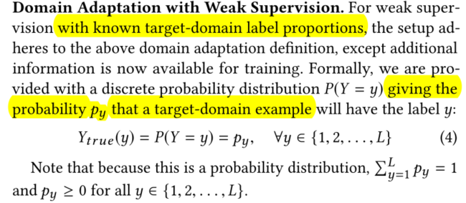
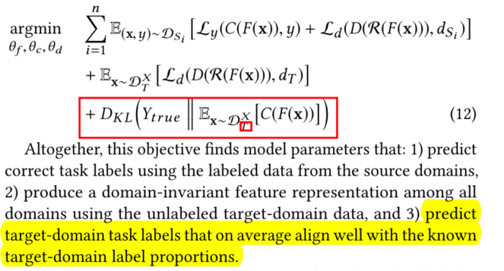
DA WITH WEAK SUPERVISION
The general principle is to use the weak supervision information as constraints to efficiently search for good model parameters.

Slide 12
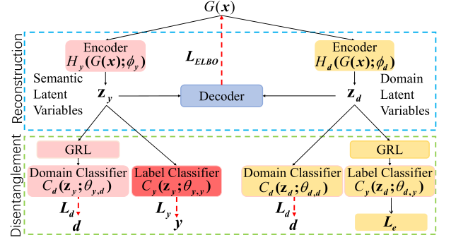
Idea
BSR
方法：Disentangled Semantic Representation for Domain Adaptation
数据：
MIMIC-III-AHRF (age group to age group)
MIMIC-III-ICD9
RF-data
HAR (participants to participant )

